Slide 1
Reverse engineering using water immersion
Prajwal Raut
Vishal kumar Jamuar

Slide 2
AIM
To develop a method for reconstructing shapes of prismatic object by repetitively dipping the object in water and measuring volume changes. (MATHEMATICAL METHOD).
To implement this method by designing a suitable mechanism.(MECHANISM).

Slide 3
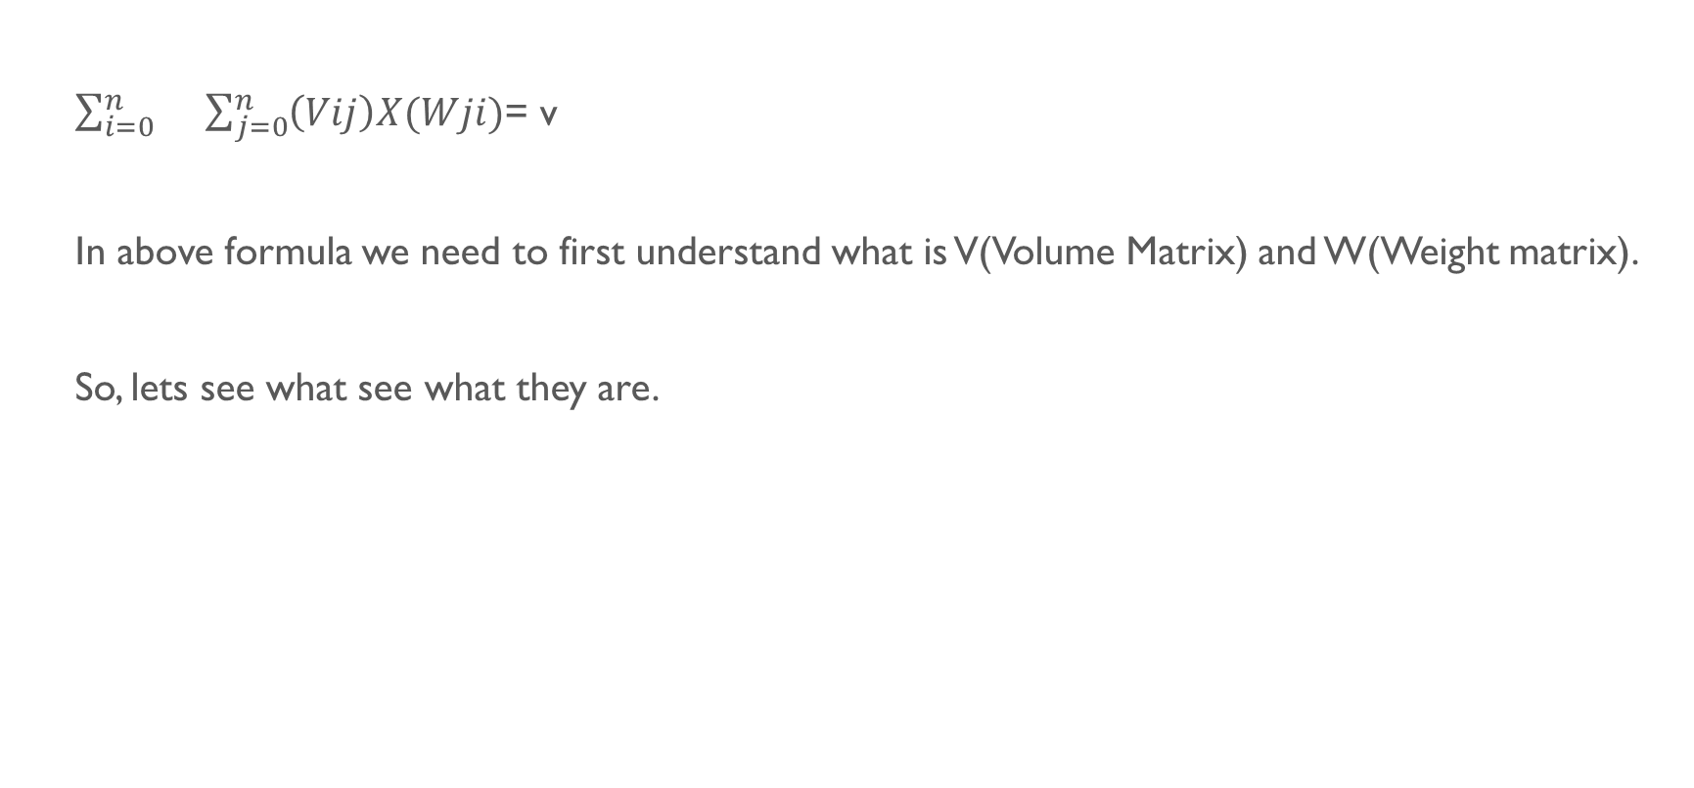
Mathematical method
$\sum_{i=0}^{n}{}\sum_{j=0}^{n}{\left(Vij\right)X(Wji)}$= v
In above formula we need to first understand what is V(Volume Matrix) and W(Weight matrix).
So, lets see what see what they are.

Slide 4
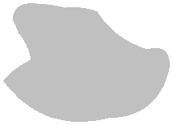
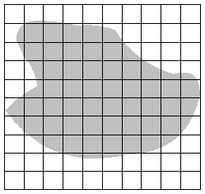
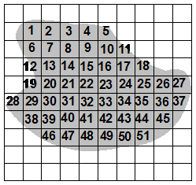
Prismatic object as 2d grid
As shown, every prismatic object can be imagined as a 2 Dimensional “n X n” square grid in which boxes are either empty or filled completely.
Value of n can be increased to gain more accuracy in the process.

Slide 5
Volume matrix
We define volume matrix ‘V’ as a 2D “n X n” binary matrix which corresponds to the 2D grid of prismatic object such that
Vij = 1 , if box at (i,j) in 2D grid is filled.
Vij = 0, if box at (i,j) in 2D grid is empty.
So, for the object shown in fig. the volume matrix will value 1 at co-ordinates corresponding to numbered boxes. Elsewhere, it will be 0.

Slide 6
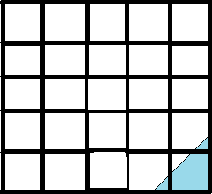
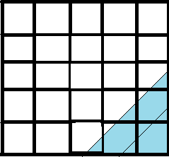
Weightage matrix
ϴ = 45 deg
ϴ = 45 deg
h = 1 unit
h = 2 units
What is weightage matrix?
For defining any weightage matrix, we require 2 values : Height (h) and Angle (ϴ).
As shown above, imagine that a “n X n” grid is rotated by ‘ϴ’ degrees counterclockwise and then it is vertically submerged in water by height ‘h’.
Then the matrix ‘W’ such that Wij is equal to percentage of water in box at (i,j) in grid will be Weightage Matrix.
We have made a c++ program which outputs weightage matrix after giving required parameters. Algorithm behind solving this has also been explained in report.

Slide 7
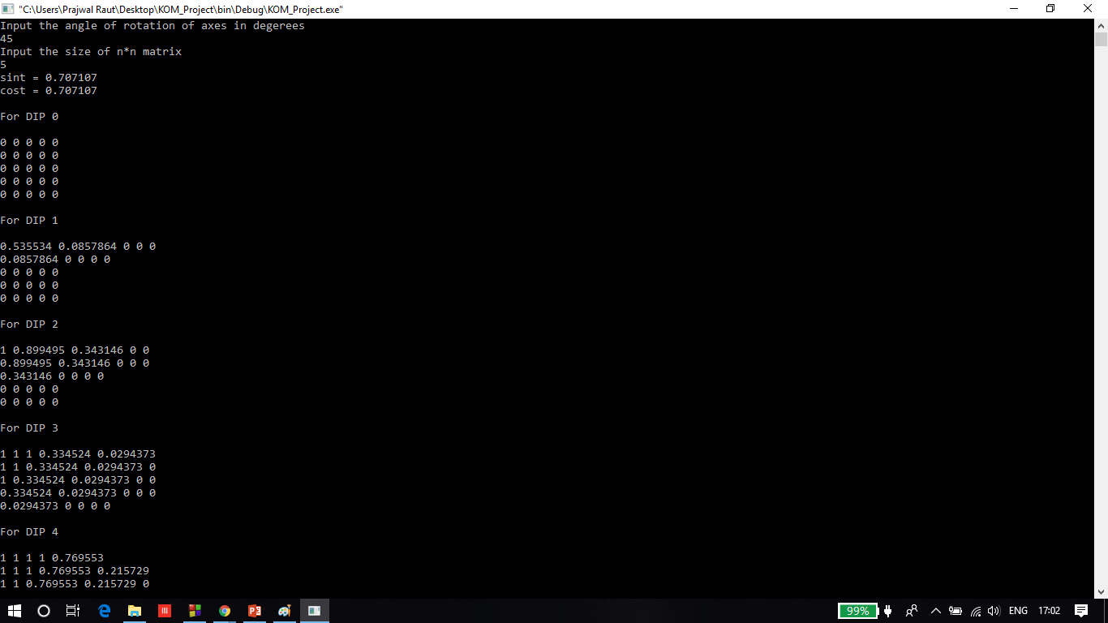

Slide 8
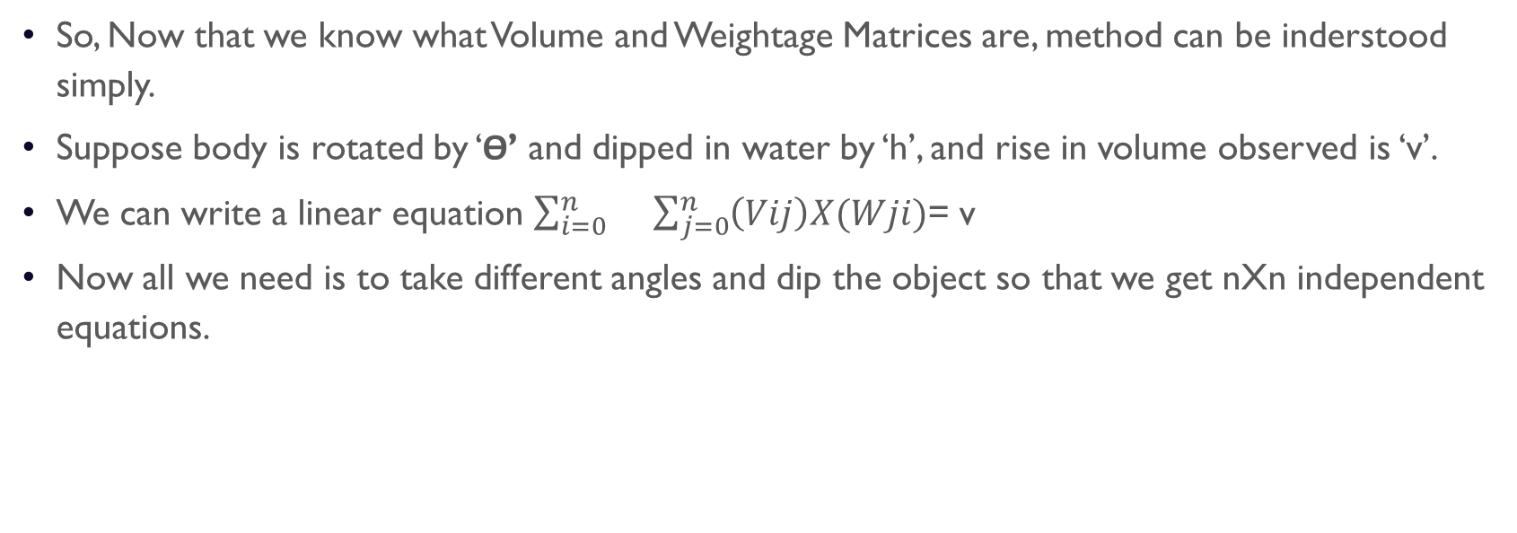
Final Method
So, Now that we know what Volume and Weightage Matrices are, method can be inderstood simply.
Suppose body is rotated by ‘ϴ’ and dipped in water by ‘h’, and rise in volume observed is ‘v’.
We can write a linear equation $\sum_{i=0}^{n}{}\sum_{j=0}^{n}{\left(Vij\right)X(Wji)}$= v
Now all we need is to take different angles and dip the object so that we get nXn independent equations.

Slide 9
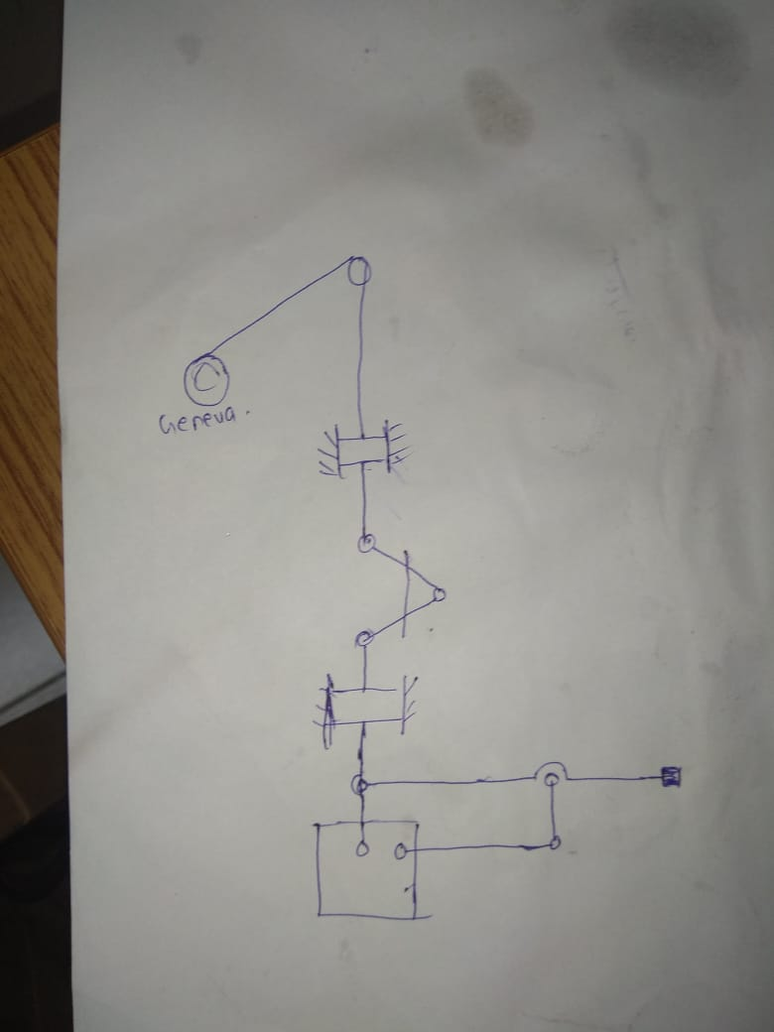
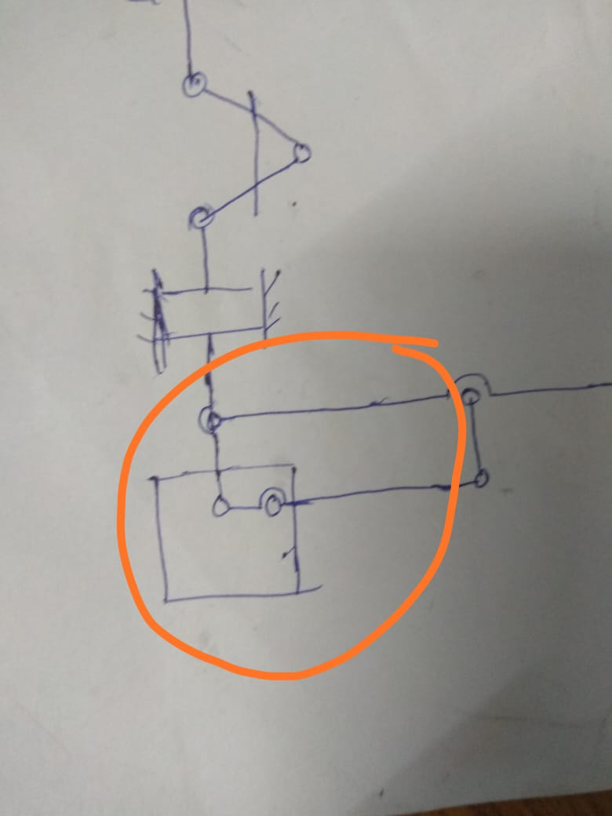
Mechanism
MODEL OF MECHANISM HAS BEEN ATTACHED SEPERATELY.

Slide 10
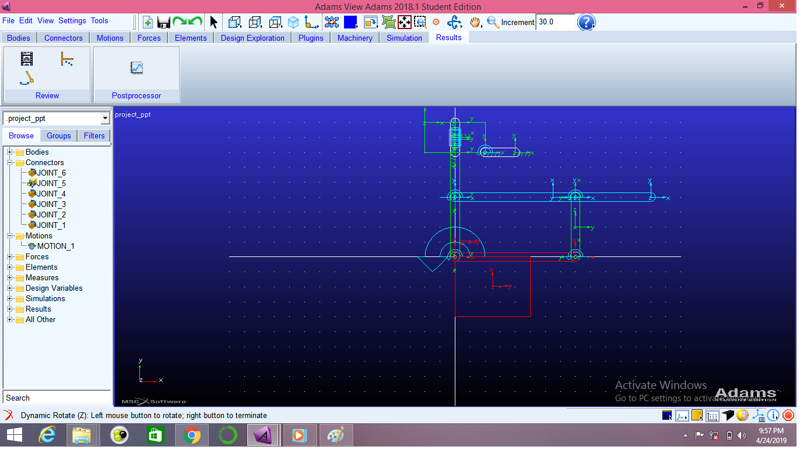

Slide 11
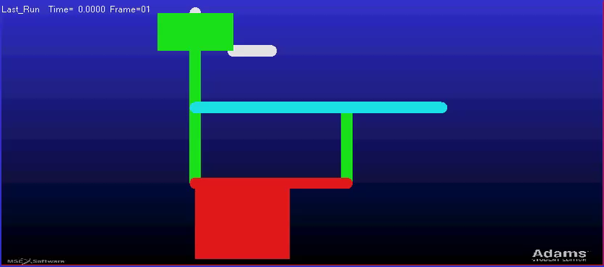
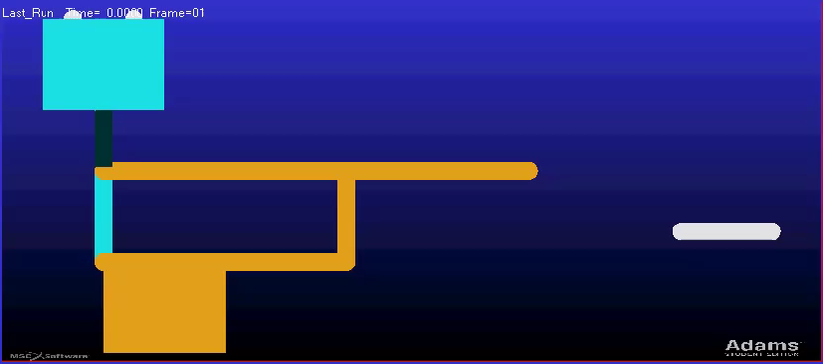

Slide 12
THANK YOU!

